Slide 1
Introduction to
deep learning
Sungjoon Choi
(sungjoon.choi@cpslab.snu.ac.kr)

Slide 2

Deep learning
Wikipedia says:
“Deep learning is a branch of machine learning based on a set of algorithms that attempt to model high-level abstractions in data by using multiple processing layers, with complex structures or otherwise, composed of multiple non-linear transformations.”
High-level
abstraction
Machine
Learning
Network

Slide 3
Deep learning
Artificial Intelligence
Machine Learning
Deep learning
MLP
CNN
RNN

Slide 4
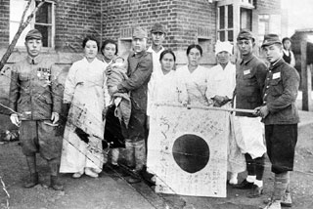
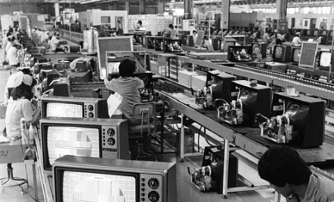
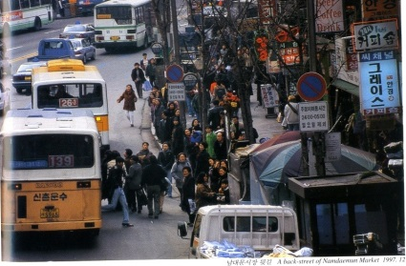
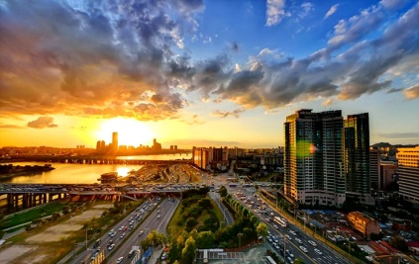
Is it brand new?
Neural Nets
McCulloch & Pitt 1943
Perception
Rosenblatt 1958
RNN
Grossberg 1973
CNN
Fukushima 1979
RBM
Hinton 1999
DBN
Hinton 2006
D-AE
Vincent 2008
AlexNet
Alex 2012
GoogLeNet
Szegedy 2015

Slide 5
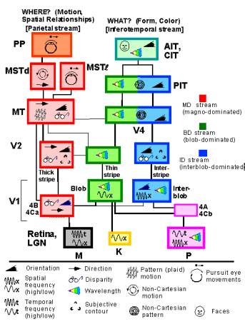
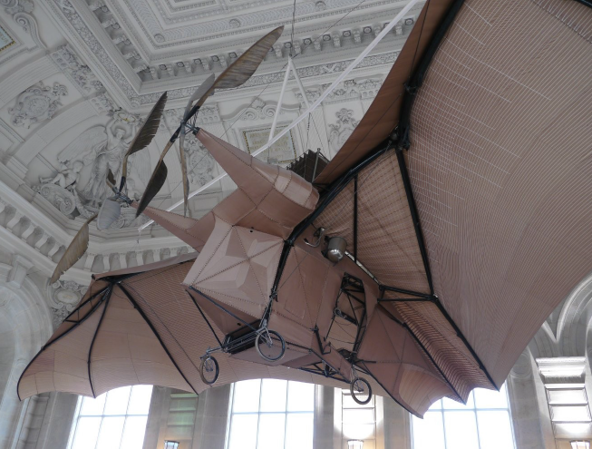
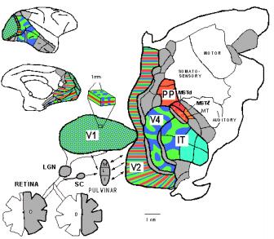
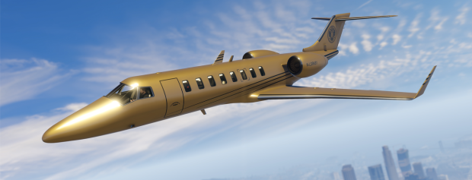
Inspired by nature?
L'Avion III de Clement Ader, 1897
Sure there is some resemblance!
But, do not go TOO FAR.
Slide credit: Yann LeCun

Slide 6
Deep architectures
Feed-Forward: multilayer neural nets, convolutional nets
Feed-Back: Stacked Sparse Coding, Deconvolutional Nets
Bi-Directional: Deep Boltzmann Machines, Stacked Auto-Encoders
Recurrent: Recurrent Nets, Long-Short Term Memory

Slide 7
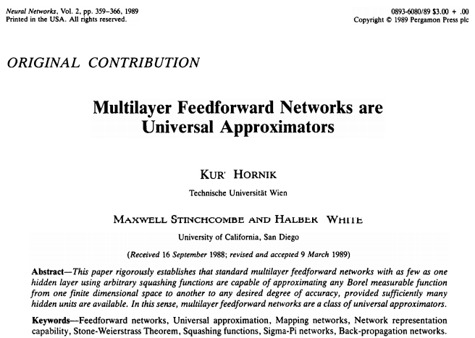
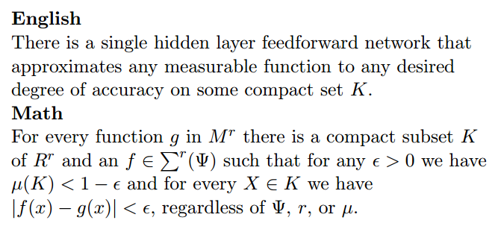
Theory
Cited > 12,000

Slide 8
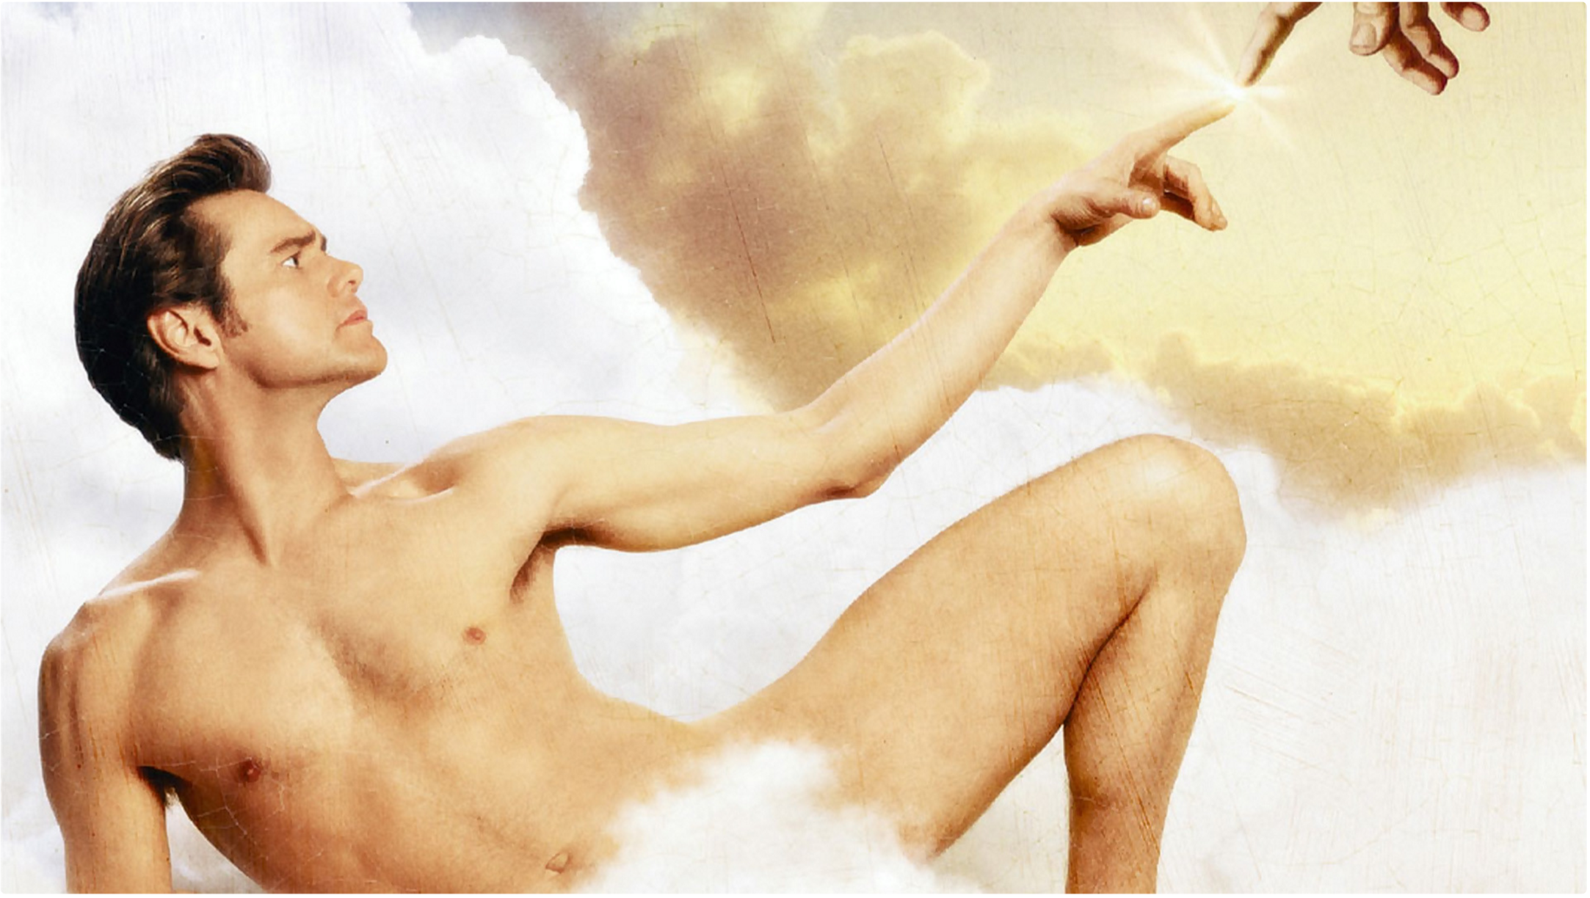
Is is omnipotent?

Slide 9
Development tools

Slide 10
Deep learning tools?
MatConvNet
Theano
TensorFlow
Torch
Caffe

Slide 11
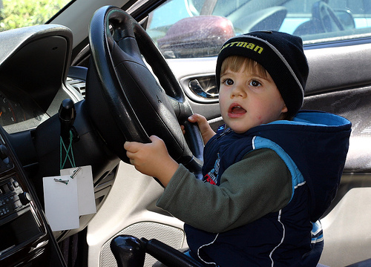
To tell the truth

Slide 12







Deep Learning Frameworks
TensorFlow
Theano
Lasagne
Keras
Caffe
Torch
mxnet

Slide 13
Pros & Cons of DL Frameworks
 | Pros | Cons
TensorFlow | Maintained by Google. Bunch of codes available. Supports Python and C++. | Too low level. Changing to rapidly.
Theano | Stable. Supports Python. | Low-level. Not good for multi-GPUs.
Lasagne | Library works on top of Theoan. | Keras seems better.
Keras | Super easy that works on top of TensorFlow and Theano. | Too simple.
Caffe | Super easy for simple computer vision tasks. | Have to program in C++. Documentation is poor.
Torch (PyTorch) | Supports Python now! More flexible compared to TF. | Lua, Lua, Lua
mxnet | Amazon’s choice. Enormous horizontal scaling capabilites!! | Newbie. Not much code to refer.

Slide 14
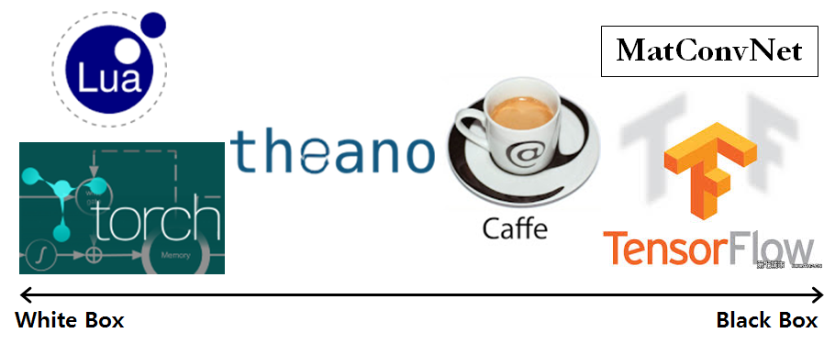
White to black

